Slide 1
ONLINE ADVERTISING SYSTEM
Y.AKSHAYA(18D41A05L1)
P.VISHNU VARDHAN(18D41A05L3)
M.YUVA KIRAN SAGAR(18D41A05M3)

Slide 2


Slide 3
CONTENTS
INTRODUCTION
OBJECTIVE
SOFTWARE REQUIREMENTS
HOME PAGE
SNAPSHOTS
DFD DIAGRAM
ER DIAGRAM
CONCLUSION
REFERENCES

Slide 4
INTRODUCTION
Online advertising, also known as online marketing, digital advertising or web advertising, is a form of marketing and advertising which uses the Internet to deliver promotional marketing messages to consumers.
Advertisement management system project is a complete online solution for advertisers who want to advertise their product on online media or websites. Advertisement Management System project is developed using ASP.NET and SQL server. This project is developed for the users who want to manage their online advertisement from one place. This website is very helpful to advertisement agency staffs and managers to manage advertisements and to view reports.
This project report gives overall system information of the system. Here you can get DFD and ER diagram of the advertisement management system. In this project report we have also explained the different module of advertisement management system. This project report can be used for system design, system development and system testing. It provides information for understanding the system.

Slide 5
OBJECTIVE
Now a day’s people are purchasing products online. Therefore, it is necessary for the company to advertise their product online. Online advertisement is a very complicated task we need a system to manage it. Advertisement management system helps to manage online advertisement. This system provides the complete service for advertiser to introduce their products and services into online market. Advertisement management system will give the solution of all problems that comes in online marketing. In this system user can create ads and can also select website where he want to show their ads online.

Slide 6
Operating Environment:
Front End: ASP.NET
Back End: SQL Server
Software Requirements:
OPERATING SYSTEM:WINDOWS OR HIGHER VERSION
TECHNIQUES:JDK 1.7
DATA BASES: MYSQL
SERVER: APACHE TOMCAT

Slide 7
HOME PAGE
Home page is the first page of the website. When user go the website of advertisement management system this is the first page that will display to user.
Following links are displayed on home page.
Home
Customer
Seller
Admin

Slide 8
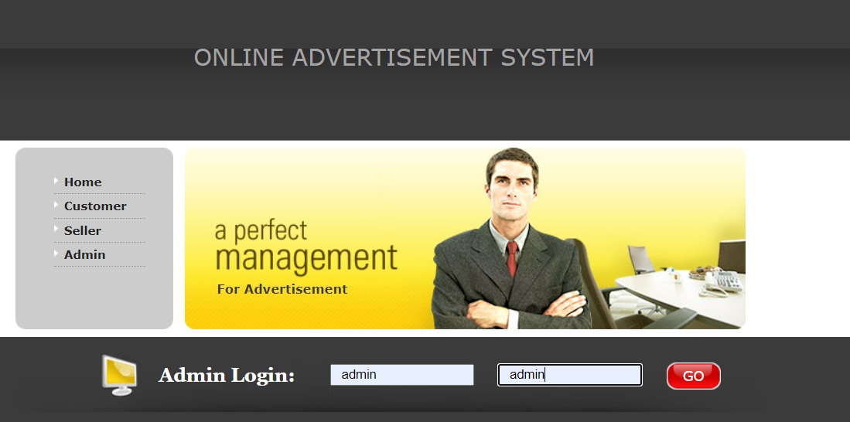
Home page : Home page is look like given below.

Slide 9
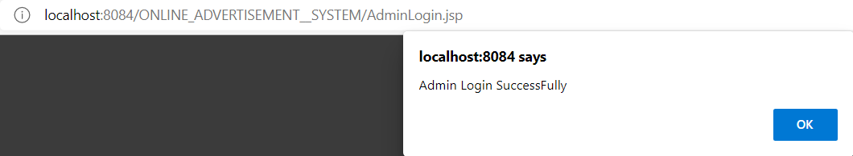
Admin login successful

Slide 10
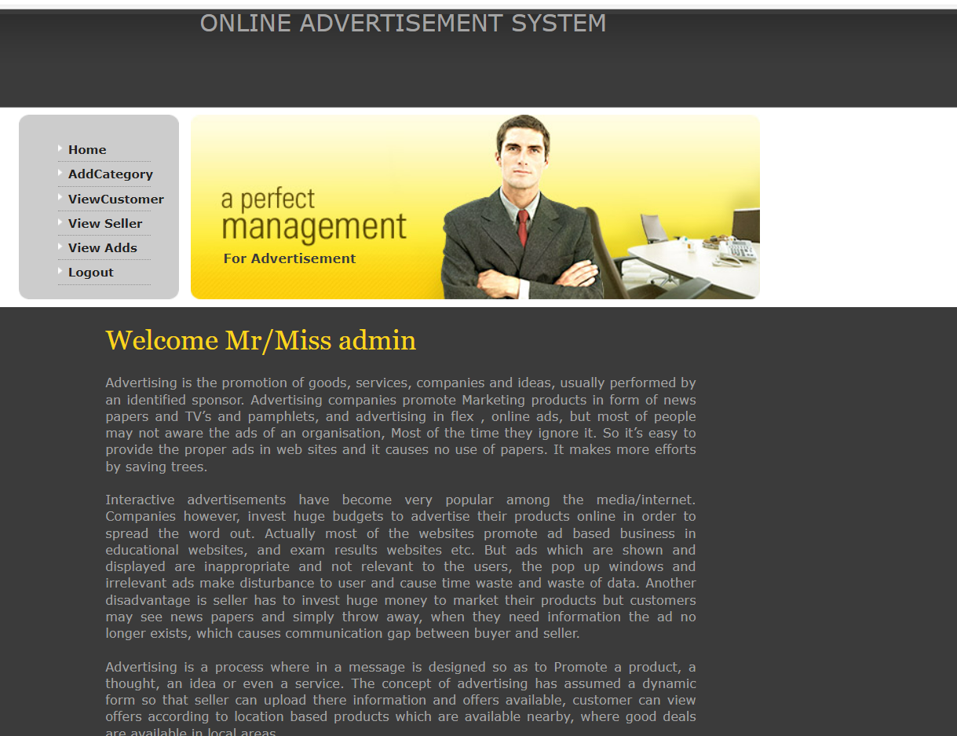
From home page we can navigate to various page like login page, sign up page and about us page.

Slide 11
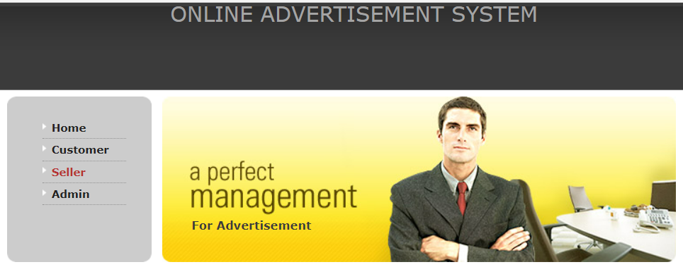
SELLER REGISTERATION

Slide 12
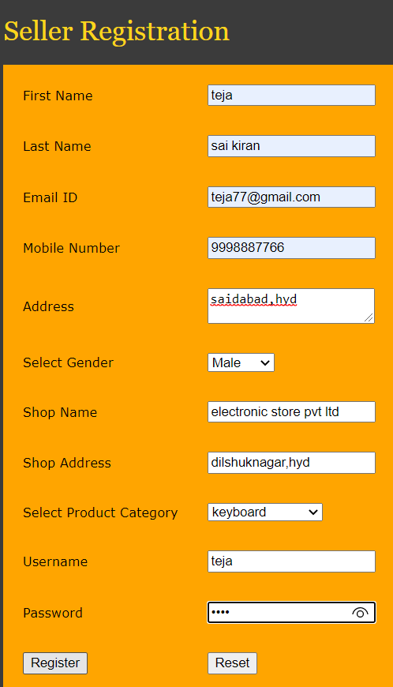
SELLER REGISTERATION FORM

Slide 13
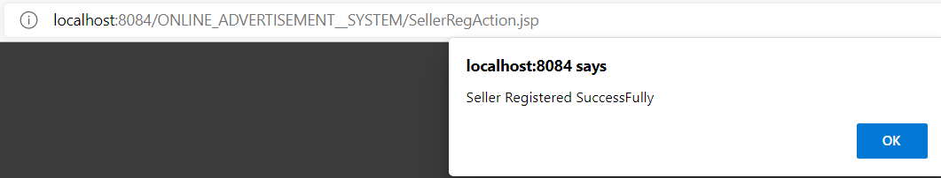
SELLER REGISTERATION SUCCESSFUL

Slide 14
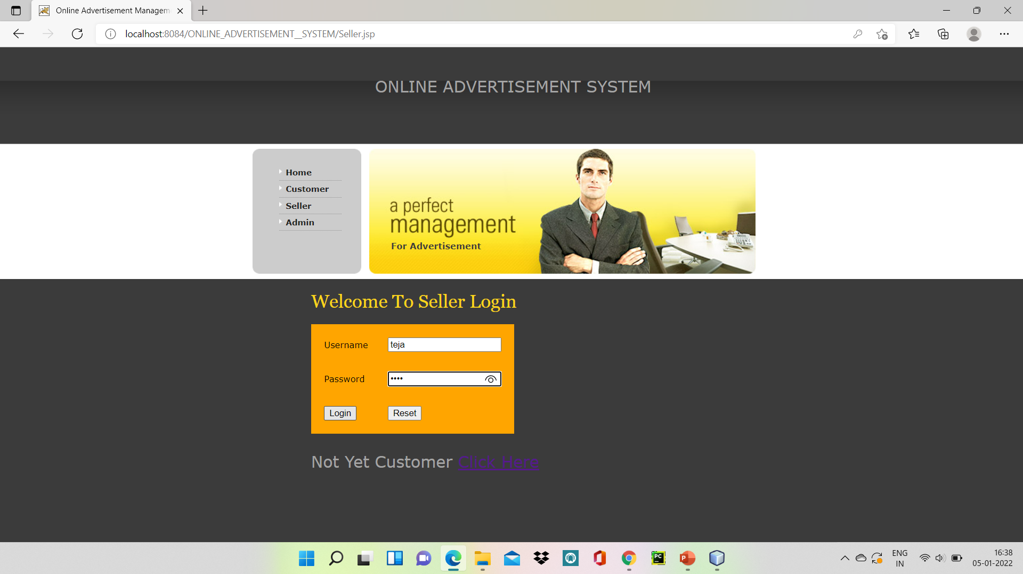
SELLER LOGIN

Slide 15
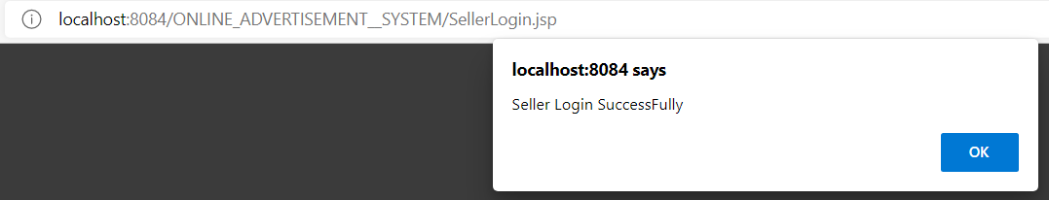
SELLER LOGIN SUCCESSFUL

Slide 16
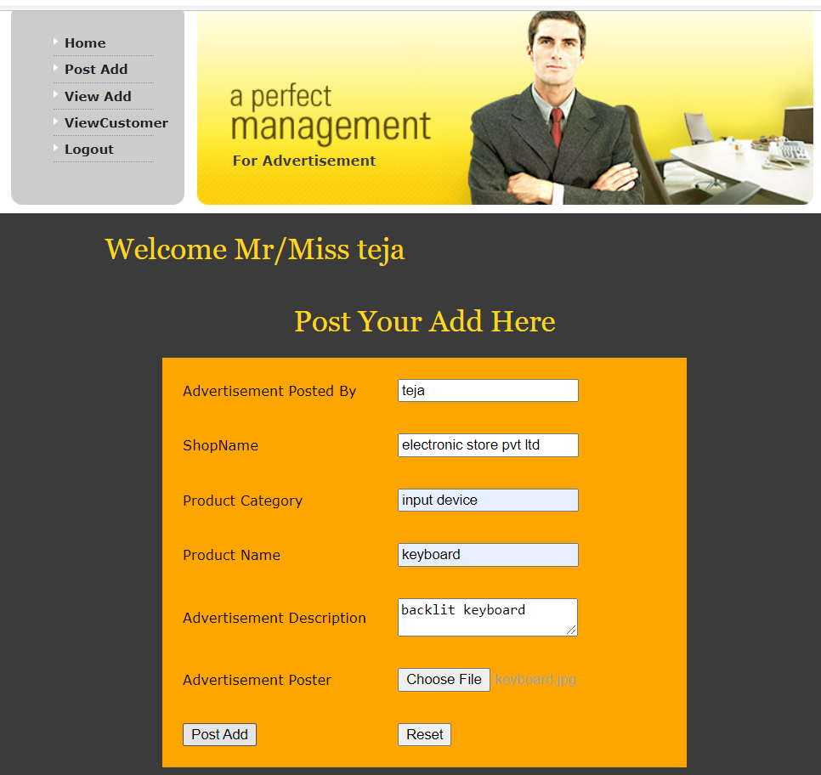
POSTING THE ADD

Slide 17
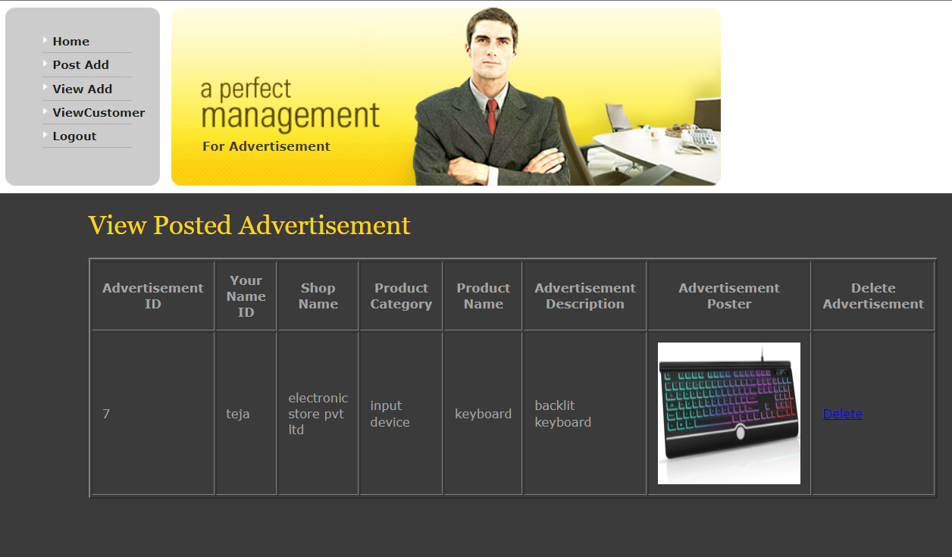
VIEW ADD

Slide 18

CUSTOMER REGISTERATION

Slide 19
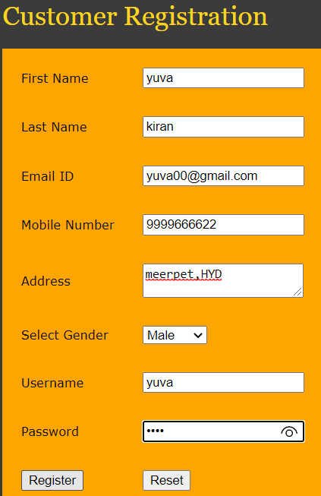
CUSTOMER R REGISTERATION FORM

Slide 20
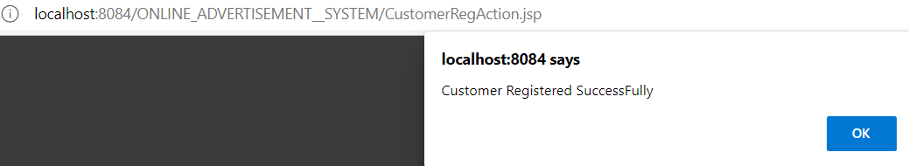
CUSTOMER REGISTERATION SUCCESSFUL

Slide 21
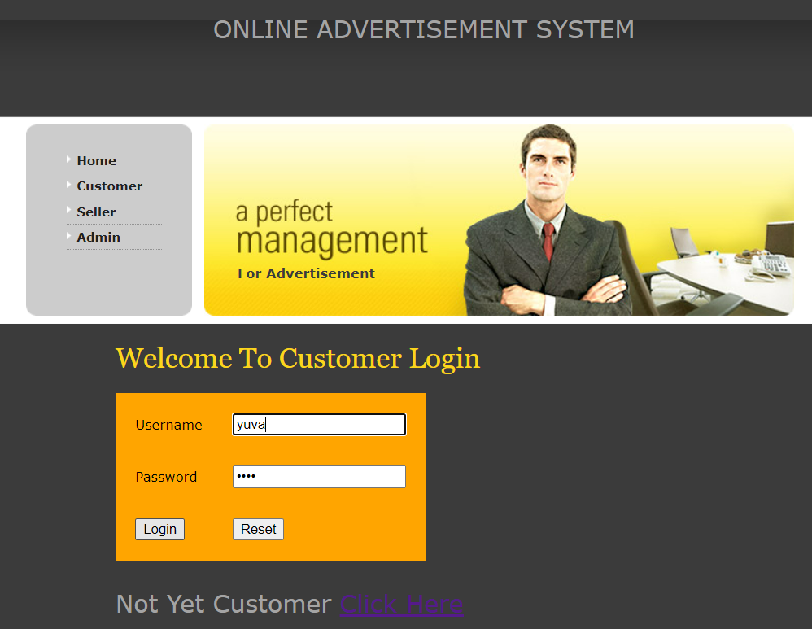
CUSTOMER LOGIN

Slide 22

CUSTOMER LOGIN SUCCESSFUL

Slide 23
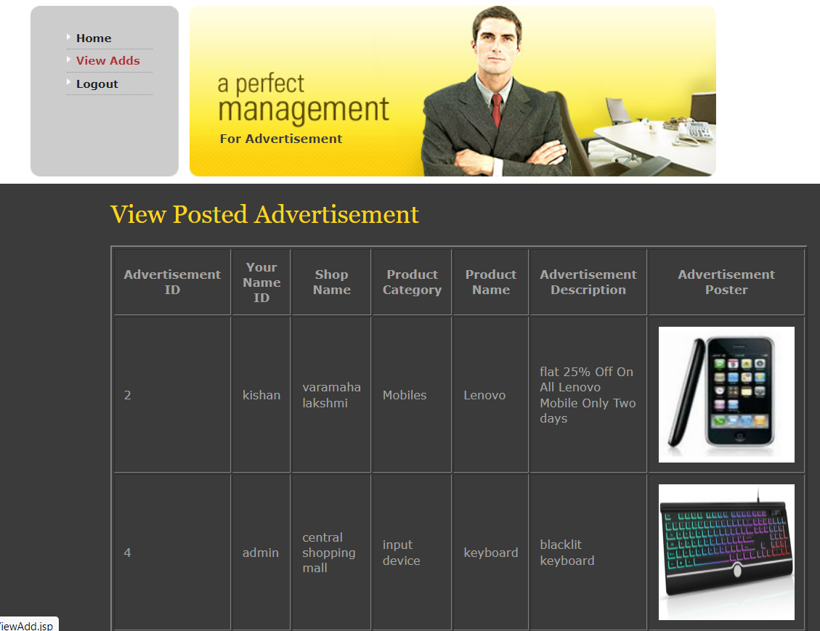
VIEW ADDS

Slide 24
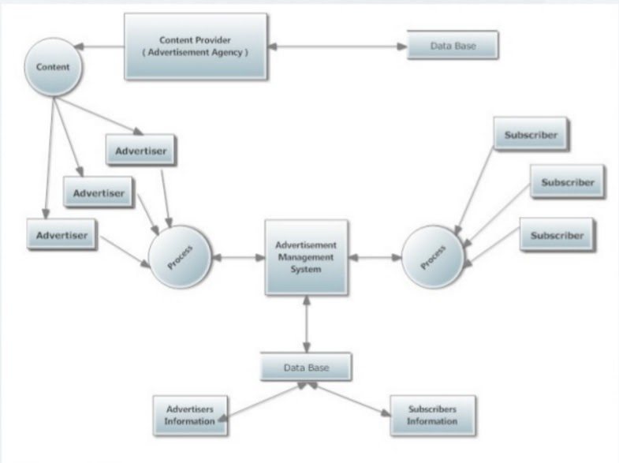
DFD diagram

Slide 25
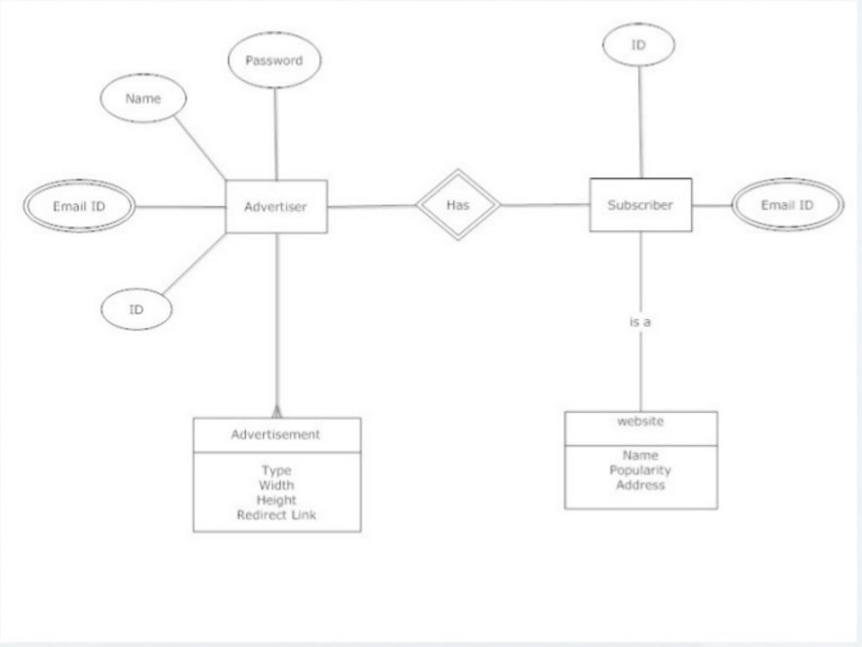
ER diagram of advertisement management system

Slide 26
CONCLUSION
However, some of the challenges that could impact the growth of online advertising are the issue of click frauds that occur with pay per click search engine based advertising, and certain intrusive software such as popups and adware. These problems can affect the credibility of the advertiser and the website. An economic slowdown can also negatively impact the growth of online advertising as companies resort to cutting their advertising expenses during an economic crisis.

Slide 27
REFERENCES
JAVA Technologies
JAVA Complete Reference
Java Script Programming by Yehuda Shiran
JAVA2 Networking by Pistoria
JAVA Security by Scotl oaks
J2EE Professional by Shadab siddiqui
JAVA server pages by Larne Pekowsley
JAVA Server pages by Nick Todd HTML

Slide 28
THANK YOU

